Slide 1
Beef Across Kansas: Nutrition 101
Dr. Colton Robison
Consulting Nutritionist, Midwest PMS
crobison@mwpms.com

Slide 2
Overview

Slide 3
Overview:
Fundamental nutrient requirements of beef cattle

Slide 4
Overview:
Fundamental nutrient requirements of beef cattle
The basics of feed tags and nutrient analyses

Slide 5
Overview:
Fundamental nutrient requirements of beef cattle
The basics of feed tags and nutrient analyses
General guidelines for diet formulation

Slide 6
Overview:
Fundamental nutrient requirements of beef cattle
The basics of feed tags and nutrient analyses
General guidelines for diet formulation
How to transition to the next ration

Slide 7
Overview:
Fundamental nutrient requirements of beef cattle
The basics of feed tags and nutrient analyses
General guidelines for diet formulation
How to transition to the next ration
Managing weight gain

Slide 8
Overview:
Fundamental nutrient requirements of beef cattle
The basics of feed tags and nutrient analyses
General guidelines for diet formulation
How to transition to the next ration
Managing weight gain
Feed storage and delivery

Slide 9
Nutrient Requirements
Water
Protein
Carbohydrates
Fats
Minerals
Vitamins

Slide 10
Net Weight
Product Name
Purpose
Guaranteed Analysis
Ingredient List
Directions For Use
Precautionary Statements
Name and Address of Manufacturer

Slide 11
Crude Protein
Protein is commonly expressed as crude protein (%)
Measured by multiplying the nitrogen value by 6.25
Supports muscle growth, intake, and performance
Rumen degradable protein (RDP)
Rumen undegradable protein (RUP)
Microbial Crude Protein (MCP)
Non-protein Nitrogen (NPN)

Slide 12
Crude Protein
Protein requirement depends on:
Weight and size
Stage of production
Level of expected performance….to a point
“General” guidelines for growing and finishing cattle
400 to 600 lbs (16 to 18% CP)
600 to 900 lbs (14 to 16% CP)
900+ lbs (12.5 to 14% CP)
These are on a dry matter basis (without water)!!!
These guidelines are generic and should be adjusted as necessary to fit your end goal

Slide 13
Crude Fiber
Crude fiber is a traditional measure of fiber content in feeds
ADF & NDF
Used to estimate energy content
Closely related to “roughage” content
“General” guidelines for crude fiber
Starter/grower rations = 15 to 25% CF (30 to 45% roughage)
Finishing rations = 6 to 8% CF (10 to 15% roughage)

Slide 14
Crude Fat
Highly related to energy content of feed
Energy content is reported as TDN, NEm, and NEg
Generally added to provide 2-3% supplemental fat
Oilseeds: canola, Soybean, sunflower, cottonseed, corn
Animal sources: Choice white grease and tallow
Food industry: Yellow grease

Slide 15
Crude Fat
“General” guidelines for dietary fat levels
Starter/grower rations = 1-3% crude fat
Finisher rations = 4.5-5.5% crude fat
Can negatively impact performance if levels increase beyond 7%
Toxic to rumen microbes

Slide 16
Minerals
Two classes of minerals: Macro and Micro
Important to consider:
Prevent deficiencies
Supports development and growth
Supports the immune system
Macrominerals
Expressed as a % of the diet
Ca, P, Mg, S, Na, Cl, K
Microminerals
Expressed in parts per million (ppm)
Ex: Co, Cu, I, Mn, Se, Zn

Slide 17
Vitamins
Important for growth, reproduction, body development, etc..
Expressed as IU/lb
Vitamin A and E should receive the most attention
Vitamin D should be considered when sunlight exposure is minimal
Most commercial feeds are adequate in vitamin and mineral concentrations
“General” guidelines for vitamin concentrations
Vit A: 2,000 to 5,000 IU/lb
Vit E: 5 to 10 IU/lb
Vit D: 200 to 350 IU/lb bw

Slide 18
Common Additives
Beta-agonist
What is this?
Active ingredients
Common label instructions
Follow the label!!
Direct-fed microbials
Fed to support immune function and growth
Commonly incorporated as probiotic bacteria and yeast

Slide 19
Transitioning Diets
Why is the transition period important?
Digestive issues
Bloat
Acidosis

Slide 20
Transitioning Diets:
Starting cattle on starter or grower diets:
Fill calves on hay before their first day of consuming feed
Slowly introduce feed over time
Transitioning to finisher diets:
Review label directions before feeding
Usually fed alone without hay
Multiple ways to “transition slowly”
If feeding 2x/day, give 50% grower in the morning and 50% in the afternoon
Feed at 50/50 for a minimum of 5-7 days
If feeding 1x/day, mix 50/50 for a min of 5-7 days
Increases in the feed amount should be gradual (1 lb or less) during the transition
Never increase feed call the first day cattle are on 100% finisher
Pay attention to cattle behavior and the stool
Don’t let cattle become too hungry

Slide 21
Managing Weight Gain
Have access to a scale
Need to know:
Target weight for the show
Days until show begins
Then you can calculate required average daily gain (ADG)
Example calculation:
Current weight = 900 lbs; target weight = 1250 lb; Show date = 100 days away
Required ADG = (1250-900) / 100 = 3.5 lbs ADG needed to meet show weight
Gain will change based on the ration.. measure and adjust feed routinely!

Slide 22
Feed Storage
Spoiled feed = bad taste = low intake = low performance
Maintain feed quality by:
Storing feed away from sunlight
Clean leftover feed from the trough
Don’t buy enough feed to cover you for months
Look at the expiration date

Slide 23
Feed Delivery
Do I feed once or twice per day?
Either can work, but twice/day is preferred
Can I use a self-feeder?
Is possible but not recommended
Dangerous during transitions
Difficult to keep track of intake
Make sure there is enough room for all animals to eat!

Slide 24
Additional Thoughts
Understand that weather and pen conditions can influence weight gain
Cold temperatures = increase in feed
Muddy pens = decrease in performance
Follow feed tag directions
Especially with medicated feeds
Everyone’s situation/environment is different, so be flexible to change

Slide 25
Feel free to reach out with questions!
Colton Robison, Ph.D.
Consulting Nutritionist, Midwest PMS
crobison@mwpms.com

Slide 26
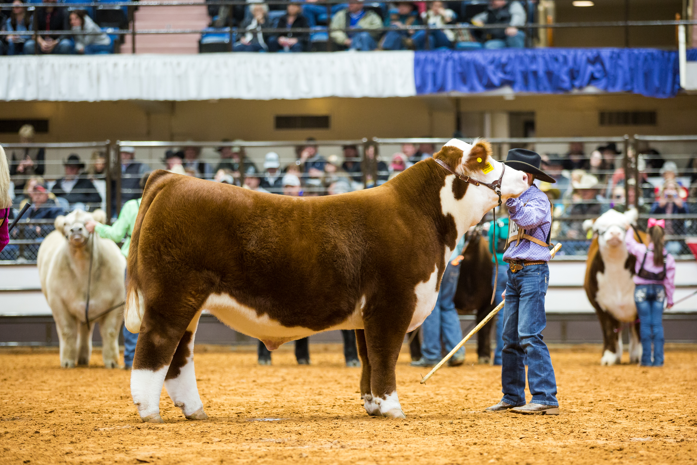
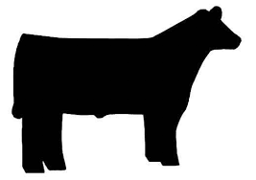
What’s Next Ty Davis Ph.D.
Feeding a Show Steer
Ty Davis, Ph.D.

Slide 27
Major things to take home
Offer HIGH quality free choice hay at all times
Make sure your feed has a mineral package included. If not either mix the recommended feeding rate of mineral in the feed or offer free choice
Weigh your cattle often. Weekly is preferred
Measure how much feed you are providing in pounds NOT scoops or buckets
Make realistic goals for your steer and what weights you want them to reach by certain dates
Notes:
Know when the show is you are going for and what weight class you want them in. weigh your cattle weekly and constantly measure how much feed you are giving them. This will make you a better cattleman and showman. DO NOT MEASURE IN SCOOPS, judges hate when you tell them how much you feed in scoops or buckets, weight it out and adjust. Go through a calendar and make realistic goals for your steer to reach a certain weight by a certain time and adjust your diet as you go. Simple calculation to tell what their ADG is and where you are headed with what you are feeding now. Know when to push and when to hold.

Slide 28
Phases of raising a show steer
Weaning
750 - 900 lbs.
Finishing

Slide 29
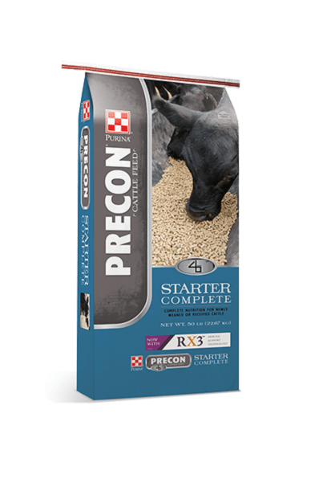
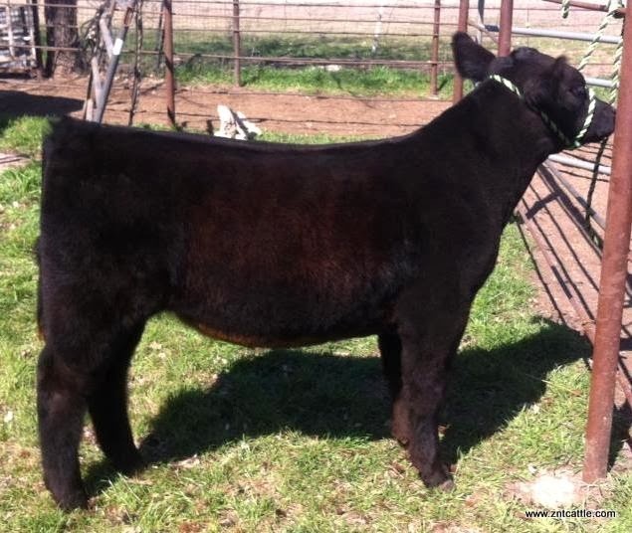
Feeding a weaned steer
Weaned cattle are dealing with a lot of stress
Don’t push them too hard at this stage
Take your time and be patient
Feed at ~3% of BW for 3 weeks until you switch to a grower diet
Notes:
Has rx3 for immune support and an organic trace mineral package to support these stressed calves. Remember they are away from their momma and being put under the stress of halter breaking, and washing and all that

Slide 30
Growing and developing a steer
This is where you can start looking into supplements
Do not push your steer too hard or they will fall apart on you
Trust the process
Notes:
These feeds typically have around 12-13% protein, 4-6% fat, 10-13% fiber product. Start by feeding around 2.5% of BW initially and see how your animal is performing on it and adjust from there.

Slide 31
Finishing a steer
This is where you can start really pushing your steer
Depending on your goal weight and your timeline, don’t be afraid to pour the feed and supplements
Notes:
You are asking your steer to perform here. If you want to get the maximum out of them you have to perform with them. This means daily washing and blowing, feeding at the same time every day, etc.
Most brands recommend you feed this around the last 120 days before the show
Typically 13-14% protein
~5% fat

Slide 32
Holding ration
Used to maintain a steer in its current body condition
In a perfect world you won’t have to use it
Notes:
Moderate energy and protein ration, high fiber to hold them where they are
Purina brand is called full control, 11% protein, 3% fat, 20% fiber

Slide 33
Making your own ration
Used if you have access to your own grains or if you don’t want to purchase a lot of show feed
Concentrate for custom mixing show cattle feeds
Notes:
High protein 32% high fat 7% and high fiber 27.5%
Recommended to be about 20% of ration
Called grand 4-t-fyer

Slide 34
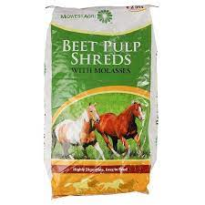
Supplements, rib shape
.
Notes:
There’s several products here that claim to add fill to your animal. With all of these supplements be sure and do your research and make sure youre not paying for snake oil. Find someone who has used the product and make sure it’s someone you trust.
These are high fiber products designed to expand in the gut to provide a full appearance and provide rib shape. Personally I prefer the tried and true method of providing beet pulp, I prefer dry but be careful and don’t overfeed

Slide 35
More supplements
Notes:
There are several brands that make very similar products to Purina, they are a dime a dozen and I have to reiterate that you need to do your research before purchasing any products like these to make sure they work. I am using Purina just to illustrate the point that there are many products out there that can do different things for your animal.
Deccox, promotes gut health and alleviates the risk of coccidiosis alleviate promotes proper Ph for the best environment for digestion and performance
Champion drive high protein supplement meant to provide lean tissue on the round and topline area
Depth charge is what I mentioned earlier and provides rib shape
Fitter 35 and fitter 52 only alter in protein percentage and it depends on how aggressive you want to be. Very similar to champion drive
Heavy weight, power fuel, golden ticket, and ultra full are all high energy supplements, mostly fat to provide cover and look for the area you think needs it most.

Slide 36
Beta Agonist feeding
MAKE SURE YOUR SHOW ALLOWS YOU TO FEED THIS
Follow the feeding instructions exactly, this is not something you mess with
Pay attention to when you start feeding and stop feeding

Slide 37
Thank you! Questions? Ty Davis tdavis1@landolakes.com

